Slide 1
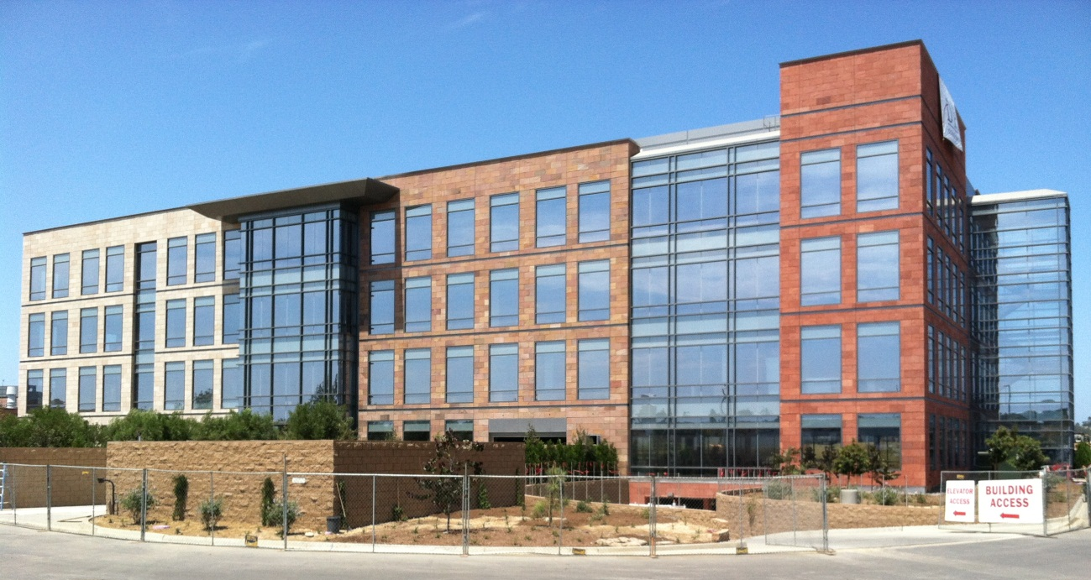
Research Facility Core and Shell (RFCS)
Presented by Tim Maffett on April 8th, 2013
Notes:
Personal Introduction: Name, Construction Management, Plans for after Graduation

Slide 2
Introduction | Presentation Overview
Research Facility Core and Shell (RFCS)
| Introduction
| Prefabricated Exterior Wall Panels
| Detailed Sequencing
| Sizing of Rigging Beam
| Solar Panel Installation at Roof Level
| Mobile Technology Integration- Tablet Computers
| Recommendations
| Concluding Remarks
Presented by Tim Maffett on April 8th, 2013

Slide 3
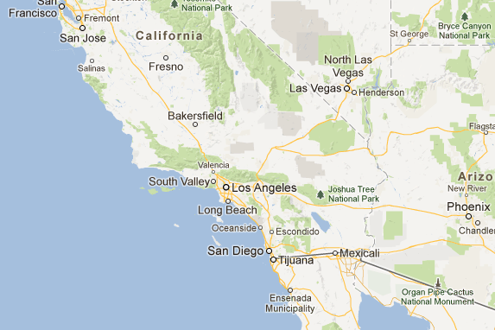

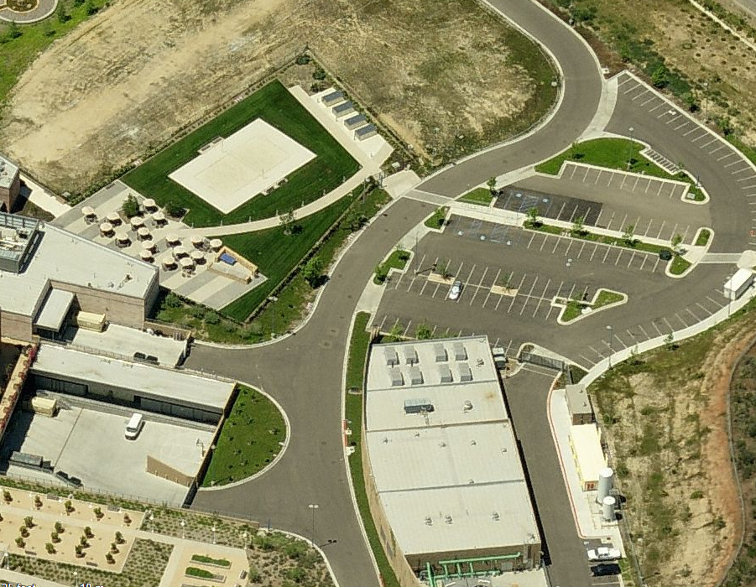
Introduction | Building Statistics
| Introduction
| Prefabricated Exterior Wall Panels
| Detailed Sequencing
| Sizing of Rigging Beam
| Solar Panel Installation at Roof Level
| Mobile Technology Integration- Tablet Computers
Name | Research Facility Core and Shell (RFCS)
Location | Southern California
Building Use | Research Facility with Office Space
Owner | Faction
Architect | Dowler-Gruman Architects
General Contractor | DPR Construction
| Recommendations
| Concluding Remarks

Slide 4
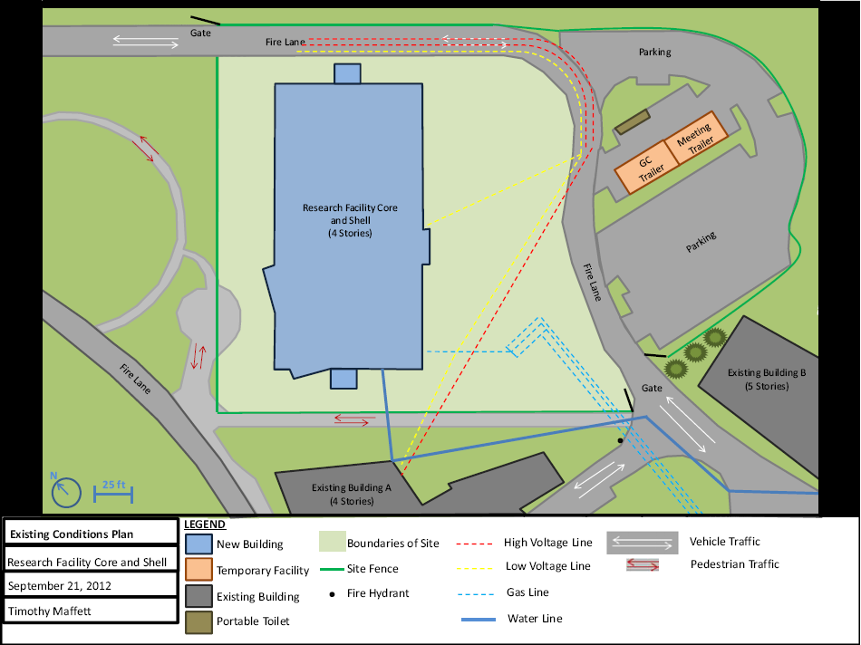
Introduction | Building Statistics
| Introduction
| Prefabricated Exterior Wall Panels
| Detailed Sequencing
| Sizing of Rigging Beam
| Solar Panel Installation at Roof Level
| Mobile Technology Integration- Tablet Computers
Name | Research Facility Core and Shell (RFCS)
Project Delivery Method | Design-Bid-Build
Contract Type | GMP
Size | 130,000 SF
Cost | $20,000,000
Schedule | 18 Months
| Recommendations
| Concluding Remarks

Slide 5

Introduction | Design Goal
Design Goal
| Introduction
| Prefabricated Exterior Wall Panels
| Detailed Sequencing
| Sizing of Rigging Beam
| Solar Panel Installation at Roof Level
Increase value through innovative and efficient construction.
| Mobile Technology Integration- Tablet Computers
| Recommendations
| Concluding Remarks

Slide 6
Prefabricated Exterior Panels | Overview
| Introduction
| Prefabricated Exterior Wall Panels
| Detailed Sequencing
| Sizing of Rigging Beam
Prefabricated Exterior Wall Panels
| Solar Panel Installation at Roof Level
| Mobile Technology Integration- Tablet Computers
| Recommendations
| Concluding Remarks

Slide 7
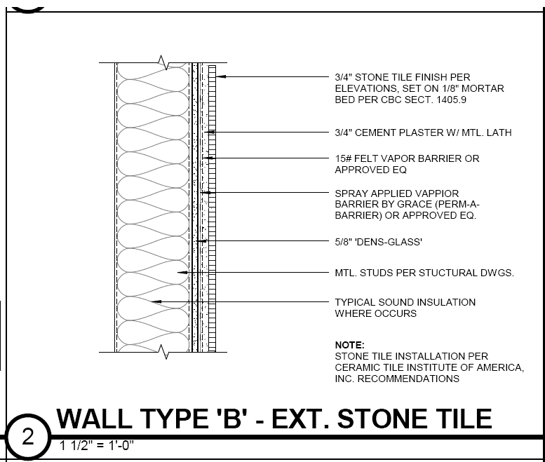
Prefabricated Exterior Panels | Problem Identification
Existing System
| Introduction
| Prefabricated Exterior Wall Panels
| Detailed Sequencing
Stick-built metal stud wall with sheathing and masonry veneer
Critical Path item for 24 weeks (1/3 of total schedule)
Created congestion on site
$1,507,959 to complete
| Sizing of Rigging Beam
| Solar Panel Installation at Roof Level
| Mobile Technology Integration- Tablet Computers
| Recommendations
| Concluding Remarks
Typical Wall Section

Slide 8
Prefabricated Exterior Panels | Solution
Proposed Solution?
| Introduction
| Prefabricated Exterior Wall Panels
| Detailed Sequencing
| Sizing of Rigging Beam
| Solar Panel Installation at Roof Level
Prefabricate exterior wall as panel modules.
| Mobile Technology Integration- Tablet Computers
| Recommendations
| Concluding Remarks

Slide 9
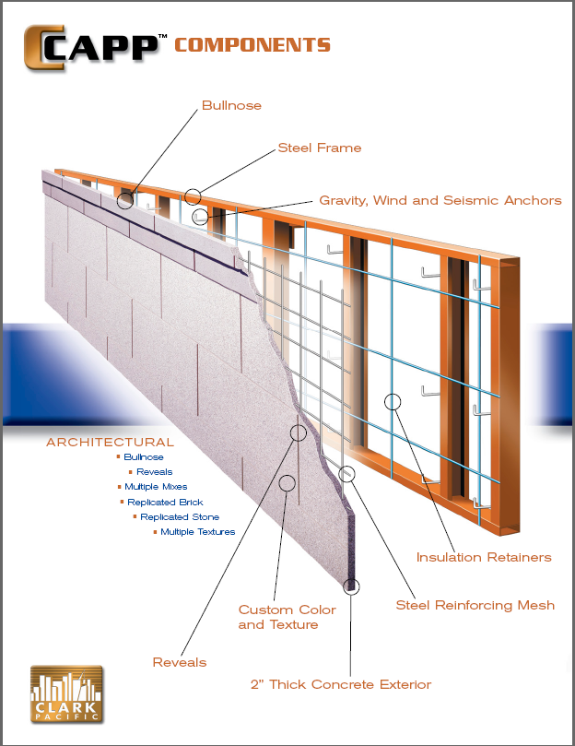
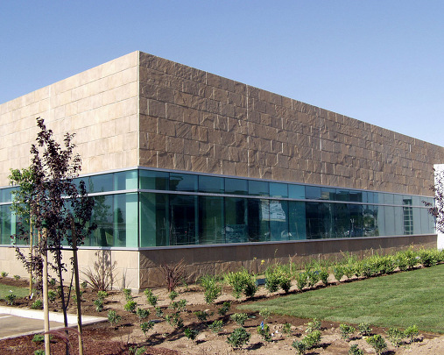
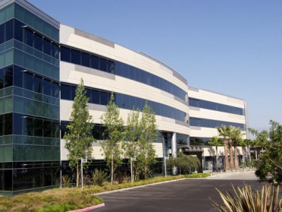
Prefabricated Exterior Panels | Alternative #1
C-CAPP Prefabricated Panel System
| Introduction
| Prefabricated Exterior Wall Panels
| Detailed Sequencing
Architectural, lightweight, precast concrete panel system
2” thick concrete skin attached to a steel frame
Durable, lightweight, closest match to existing facade
Produced by Clark Pacific
| Sizing of Rigging Beam
| Solar Panel Installation at Roof Level
| Mobile Technology Integration- Tablet Computers
| Recommendations
| Concluding Remarks
Section of C-CAPP System
Notes:
Chosen based on industry references. Prefabricated off-site and brought in

Slide 10
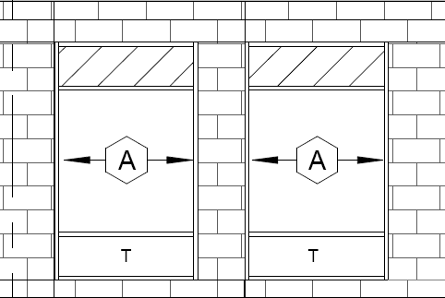
Prefabricated Exterior Panels | Alternative #1
Results
| Introduction
| Prefabricated Exterior Wall Panels
| Detailed Sequencing
Total Cost of C-CAPP System | $1,115,000
Critical Path Duration | 7 Weeks
| Sizing of Rigging Beam
| Solar Panel Installation at Roof Level
Quote on C-CAPP Prefabricated Panel System
Cost Breakdown ($) |  | Schedule (Duration)
Base Budget | $907,500 | Preliminary | Variable
Staining Panels | $99,500
Preweld Connections to Steel Structure | $75,000 | Layout and Preweld | 3 weeks
Caulking | $33,000 | Hanging Panels | 1 week
----------------------------------------------- | -------------- | Final Aligning and Welding | 3 weeks
Total Cost of System | $1,115,000 | Total Duration on site | 7 weeks
| Mobile Technology Integration- Tablet Computers
| Recommendations
| Concluding Remarks
12’ x 22’ Typical Module for C-CAPP System
Notes:
Schedule and Cost quote given by business development manager at Clark Pacific

Slide 11
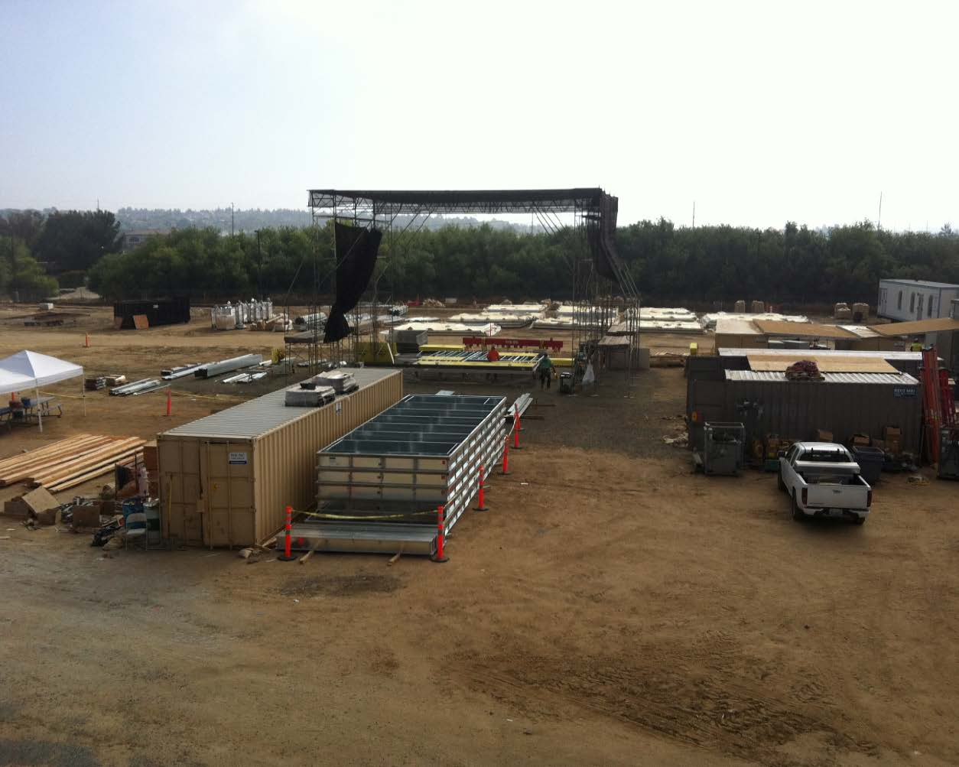
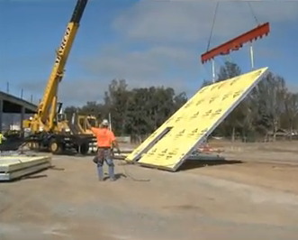
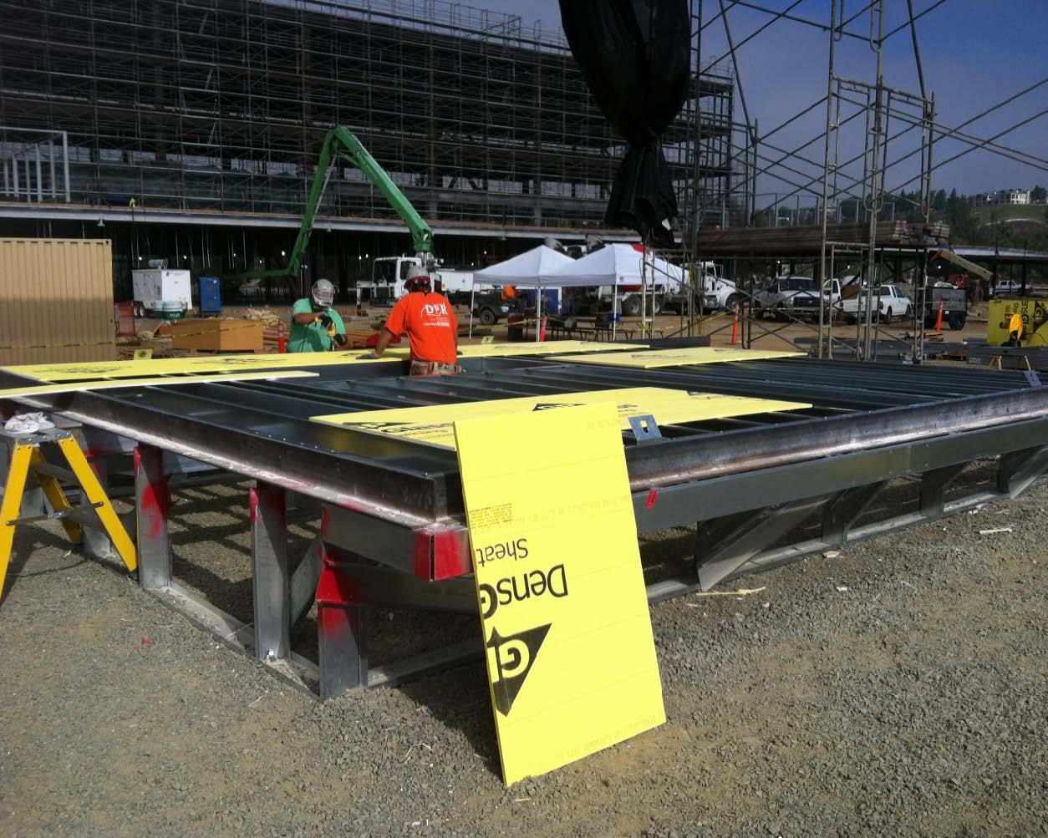
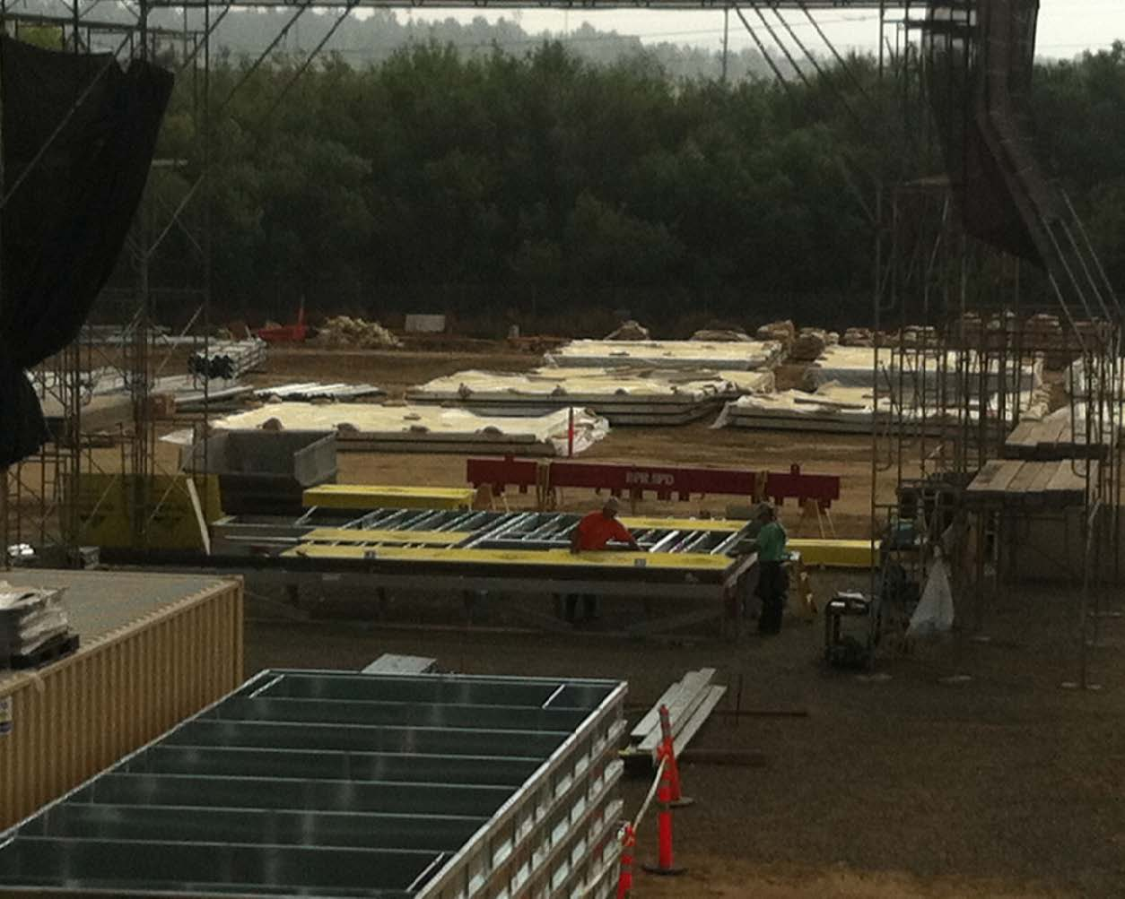
Prefabricated Exterior Panels | Alternative #2
On-Site Partial Panel Prefabrication
| Introduction
| Prefabricated Exterior Wall Panels
| Detailed Sequencing
| Sizing of Rigging Beam
| Solar Panel Installation at Roof Level
| Mobile Technology Integration- Tablet Computers
| Recommendations
| Concluding Remarks
Panel Prefabrication at Hospital in Temecula, CA

Slide 12
Prefabricated Exterior Panels | Alternative #2
Results
| Introduction
| Prefabricated Exterior Wall Panels
| Detailed Sequencing
Total Cost of Partially Prefabricated System | $1,502,007
Critical Path Duration | 21 Weeks
| Sizing of Rigging Beam
| Solar Panel Installation at Roof Level
| Mobile Technology Integration- Tablet Computers
| Recommendations
| Concluding Remarks

Slide 13
Prefabricated Exterior Panels | Chosen Alternative
Chosen Alternative
On-Site Partial Panel Prefabrication
| Introduction
| Prefabricated Exterior Wall Panels
| Detailed Sequencing
Architectural Properties | Aesthetic Match
Planning | Later in Process
Owner Hesitance| Less Anxiety
Cost | Decrease
Schedule | Decrease
Safety| Increase
| Sizing of Rigging Beam
| Solar Panel Installation at Roof Level
| Mobile Technology Integration- Tablet Computers
| Recommendations
| Concluding Remarks

Slide 14
Prefabricated Exterior Panels | System Comparison
On-Site Partial Panel Prefabrication vs. Stick-built Wall Construction
| Introduction
| Prefabricated Exterior Wall Panels
| Detailed Sequencing
Cost Savings | $5,953
Schedule Reduction | 3 Weeks
| Sizing of Rigging Beam
| Solar Panel Installation at Roof Level
| Mobile Technology Integration- Tablet Computers
Partially Prefabricated Panel Alternative vs. Original Stick Built Design
Description | Partially Prefabricated Panels | Original Stick-Built Design
Overall Cost | $1,502,007 | $1,507,960
Difference +/- | $5,953 Savings
Overall Schedule | 21 Weeks | 24 Weeks
Difference +/- | 3 Week Schedule Reduction
| Recommendations
| Concluding Remarks
Notes:
Decrease in scaffolding costs, reduction in schedule, increase in crane costs

Slide 15
Prefabricated Exterior Panels | Recommendation
Recommendation
| Introduction
| Prefabricated Exterior Wall Panels
| Detailed Sequencing
| Sizing of Rigging Beam
| Solar Panel Installation at Roof Level
Implement Partially Prefabricated Wall Panel Strategy as opposed to original stick-built construction
| Mobile Technology Integration- Tablet Computers
| Recommendations
| Concluding Remarks
Notes:
Save cost and reduce schedule allowing the building to be in use sooner thus generating profits sooner. Creates buffer period in schedule

Slide 16
Detailed Sequencing | Overview
| Introduction
| Prefabricated Exterior Wall Panels
| Detailed Sequencing
| Sizing of Rigging Beam
Detailed Sequencing of Exterior Wall Panels
| Solar Panel Installation at Roof Level
| Mobile Technology Integration- Tablet Computers
| Recommendations
| Concluding Remarks

Slide 17
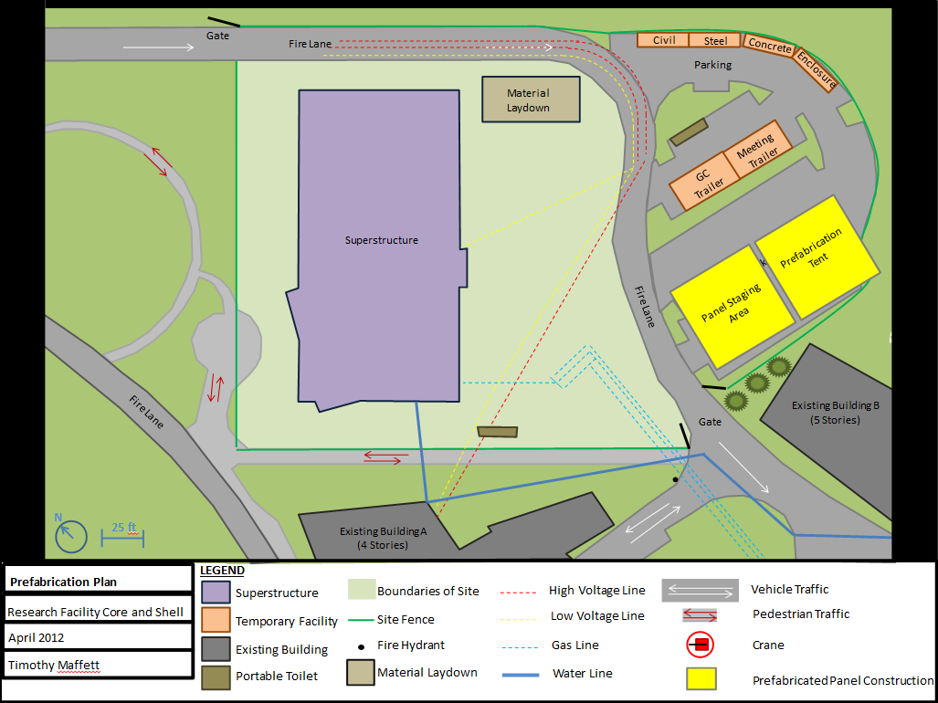
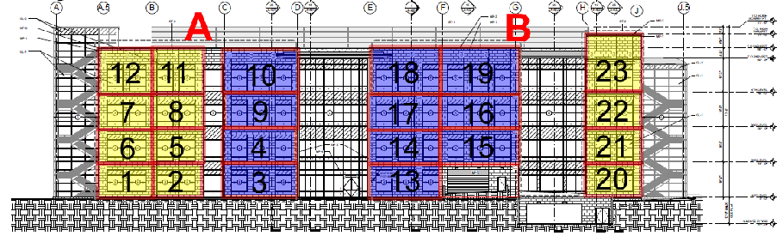
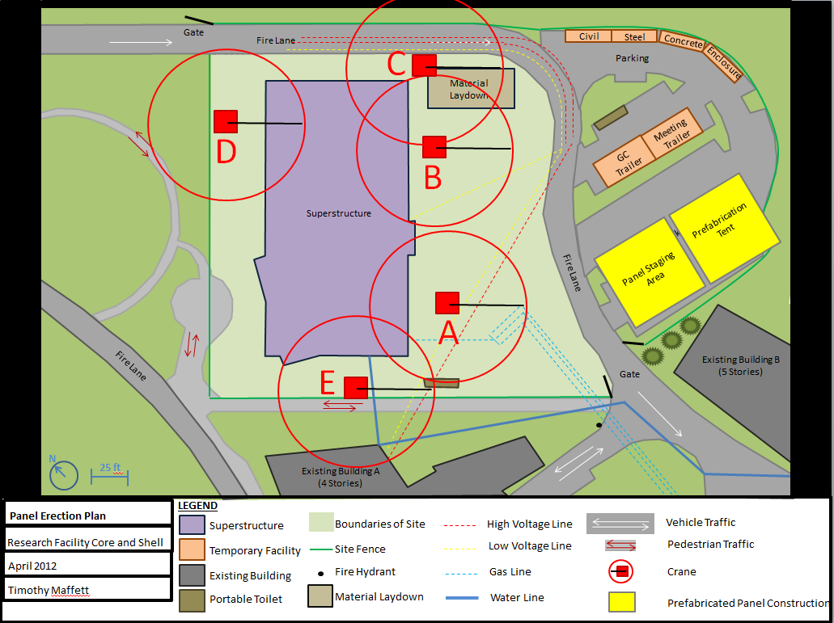
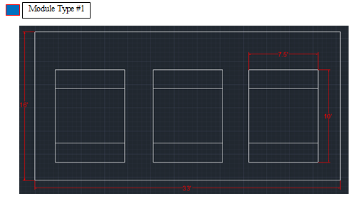
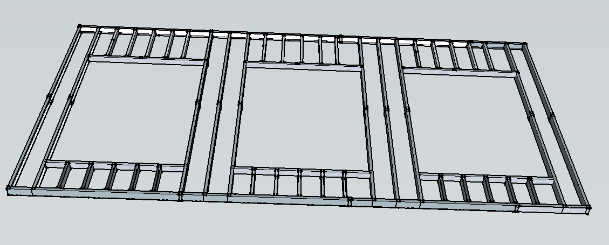
Detailed Sequencing | Constructability Concerns
Constructability Concerns
| Introduction
| Prefabricated Exterior Wall Panels
?
| Detailed Sequencing
Where on site will we build panels?
How do we modularize most efficiently?
How do we plan necessary supplies?
How do we schedule this activity?
In what order will the panels be erected?
How do we educate and create a safe environment?
| Sizing of Rigging Beam
| Solar Panel Installation at Roof Level
| Mobile Technology Integration- Tablet Computers
| Recommendations
| Concluding Remarks
Notes:
How do we modularize this building most efficiently? How do we plan for the necessary supplies? How do we schedule this activity? How will it be erected?

Slide 18
Detailed Sequencing | Prefabrication Tent & Staging
Prefabrication Tent and Staging
| Introduction
| Prefabricated Exterior Wall Panels
| Detailed Sequencing
Location | On-site and near building
Description | Metal framed tent to provide cover during construction
Staging | Tarp to cover and protect completed panels
| Sizing of Rigging Beam
| Solar Panel Installation at Roof Level
| Mobile Technology Integration- Tablet Computers
| Recommendations
| Concluding Remarks

Slide 19
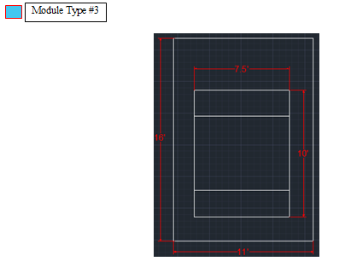
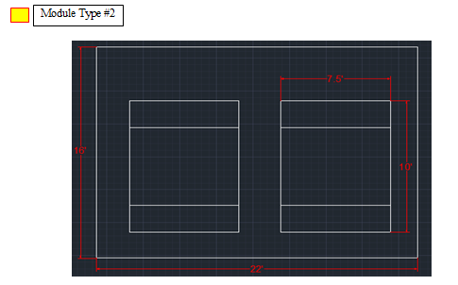
Detailed Sequencing | Module Breakdown
Module Breakdown
| Introduction
| Prefabricated Exterior Wall Panels
| Detailed Sequencing
| Sizing of Rigging Beam
| Solar Panel Installation at Roof Level
| Mobile Technology Integration- Tablet Computers
| Recommendations
Panel Module Take-Off
Description | Amount
Module Type #1 | 28
Module Type #2 | 21
Module Type #3 | 3
Total | 52 Panels
| Concluding Remarks
Module Types

Slide 20
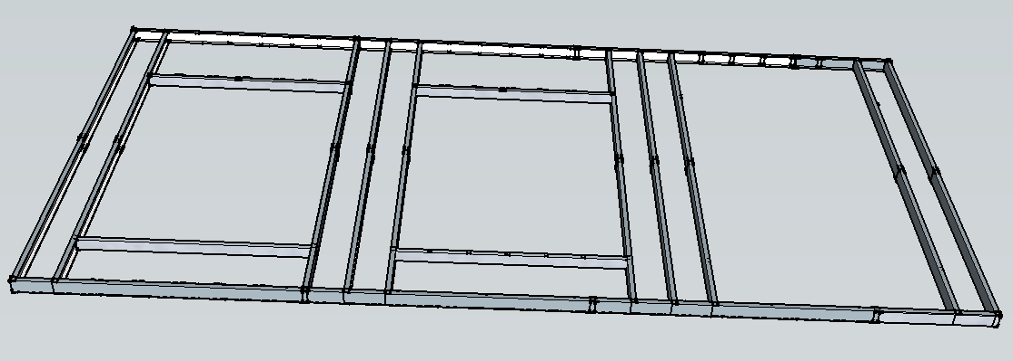
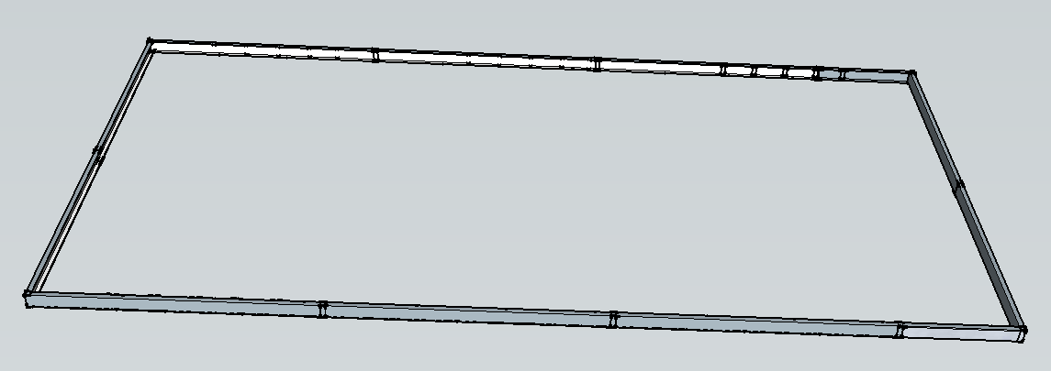
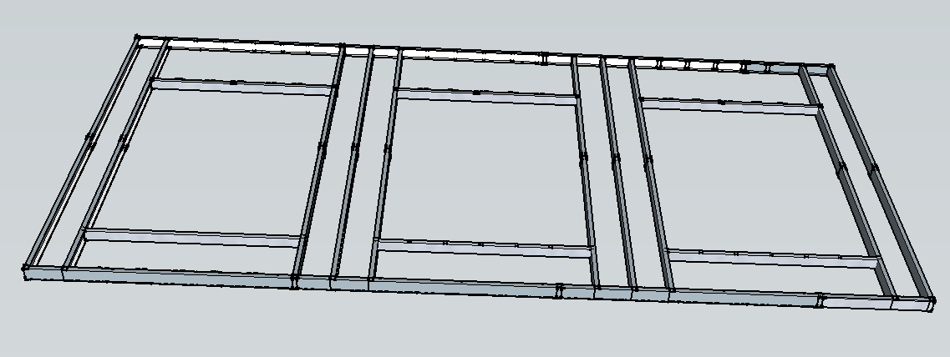
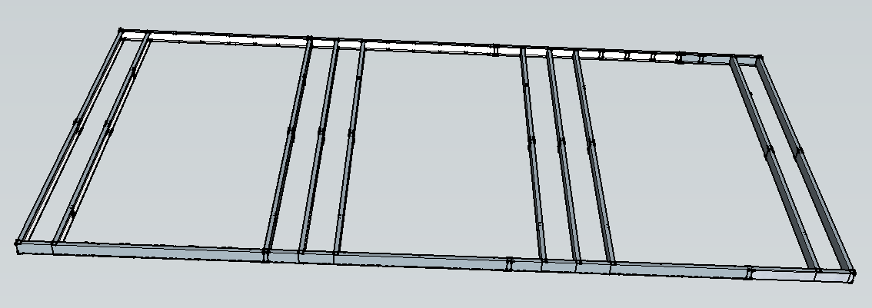
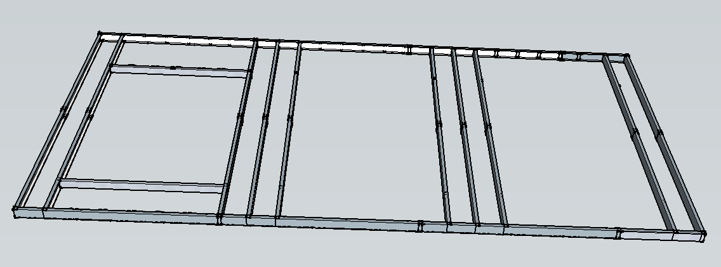
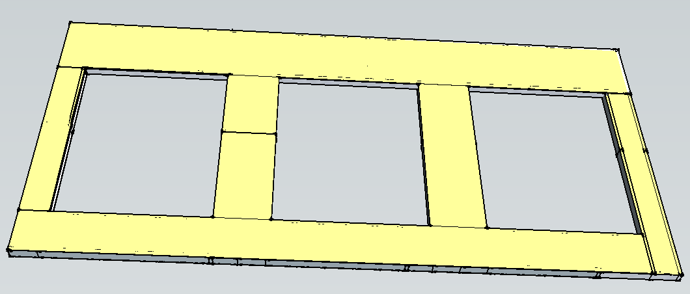
Detailed Sequencing | Building the Panel
Building the Panel
Step 4: Frame Window Opening 2
| Introduction
| Prefabricated Exterior Wall Panels
| Detailed Sequencing
Step 1: Build Outer Framing
Step 5: Frame Window Opening 3
| Sizing of Rigging Beam
| Solar Panel Installation at Roof Level
| Mobile Technology Integration- Tablet Computers
Step 2: Frame Full Length Studs
Step 6: Install Window Supports
| Recommendations
| Concluding Remarks
Step 3: Frame Window Opening 1
Step 7: Sheath Panel
Notes:
Helped to quantify the materials and duration of the activity

Slide 21
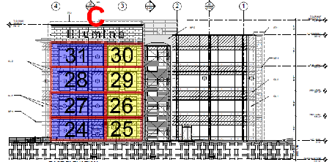
Detailed Sequencing | Erection Sequence
Erection Sequence
| Introduction
| Prefabricated Exterior Wall Panels
| Detailed Sequencing
| Sizing of Rigging Beam
| Solar Panel Installation at Roof Level
South Façade Phase A and B
| Mobile Technology Integration- Tablet Computers
| Recommendations
| Concluding Remarks
East Façade Phase C
Sequencing

Slide 22
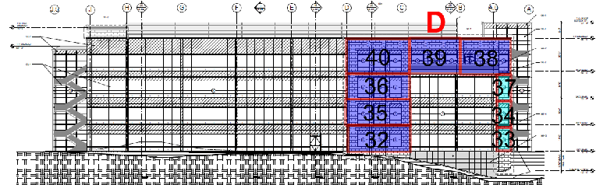
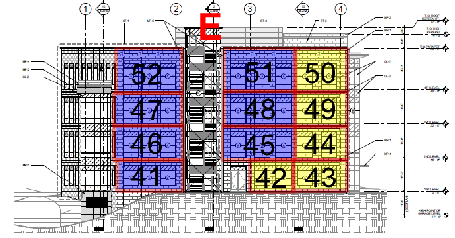
Detailed Sequencing | Erection Sequence
Erection Sequence
| Introduction
| Prefabricated Exterior Wall Panels
| Detailed Sequencing
| Sizing of Rigging Beam
| Solar Panel Installation at Roof Level
North Façade Phase D
| Mobile Technology Integration- Tablet Computers
| Recommendations
| Concluding Remarks
West Façade Phase E
Sequencing

Slide 23
Detailed Sequencing | Benefits and Outcomes
Benefits and Outcomes
| Introduction
| Prefabricated Exterior Wall Panels
| Detailed Sequencing
Thorough planning
Accurate material, schedule, and cost estimate
Provides training and management tool
Increased efficiency
Increased safety
Protection against crane sitting on site stagnantly
| Sizing of Rigging Beam
| Solar Panel Installation at Roof Level
| Mobile Technology Integration- Tablet Computers
| Recommendations
| Concluding Remarks

Slide 24
Sizing of Rigging Beam | Overview
| Introduction
| Prefabricated Exterior Wall Panels
| Detailed Sequencing
| Sizing of Rigging Beam
Sizing of Rigging Beam
| Solar Panel Installation at Roof Level
| Mobile Technology Integration- Tablet Computers
| Recommendations
| Concluding Remarks

Slide 25
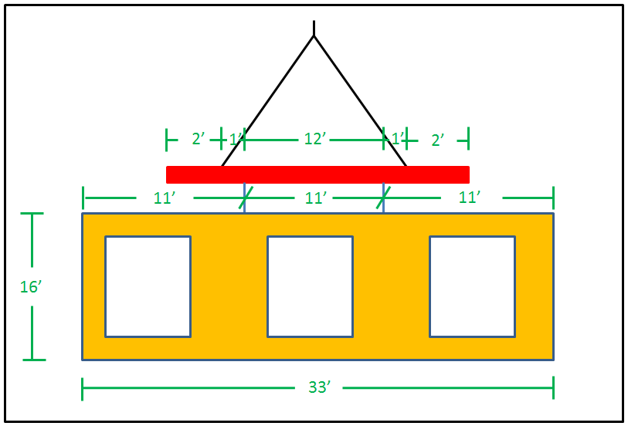
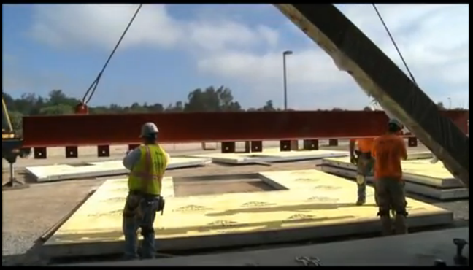
Sizing of Rigging Beam | Outcome
Outcome of Structural Breadth
| Introduction
| Prefabricated Exterior Wall Panels
| Detailed Sequencing
| Sizing of Rigging Beam
| Solar Panel Installation at Roof Level
| Mobile Technology Integration- Tablet Computers
| Recommendations
| Concluding Remarks
Results of Structural Calculations on Steel Beam in Rigging
Description | Value
Dead Weight of Panel | 1580 lb.
Maximum Shear | .790 kip
Maximum Moment | .790 kip-ft.
Rigging Beam Necessary for RFCS | W 8x10
Rigging Beam at Hospital in Temecula, CA
Notes:
Sized the beam for the largest forces it would see >> used largest panel for calculations

Slide 26
Solar Panel Installation | Overview
| Introduction
| Prefabricated Exterior Wall Panels
| Detailed Sequencing
| Sizing of Rigging Beam
Solar Panel Installation at Roof Level
| Solar Panel Installation at Roof Level
| Mobile Technology Integration- Tablet Computers
| Recommendations
| Concluding Remarks

Slide 27
Solar Panel Installation | Problem Identification
Requests of the Owner
| Introduction
| Prefabricated Exterior Wall Panels
| Detailed Sequencing
Achieve LEED Gold Certification
Develop solution without simply point chasing
Improve sustainability
Take advantage of Southern California location
| Sizing of Rigging Beam
| Solar Panel Installation at Roof Level
| Mobile Technology Integration- Tablet Computers
| Recommendations
| Concluding Remarks
Notes:
The project team finds out that they are only a few leed credits away from leed gold. Owner decides it might be worth it if appropriate solution is found.

Slide 28
Solar Panel Installation | Problem Identification
Proposed Solution?
| Introduction
| Prefabricated Exterior Wall Panels
| Detailed Sequencing
| Sizing of Rigging Beam
| Solar Panel Installation at Roof Level
Investigate implementation of solar panels on roof.
| Mobile Technology Integration- Tablet Computers
| Recommendations
| Concluding Remarks

Slide 29
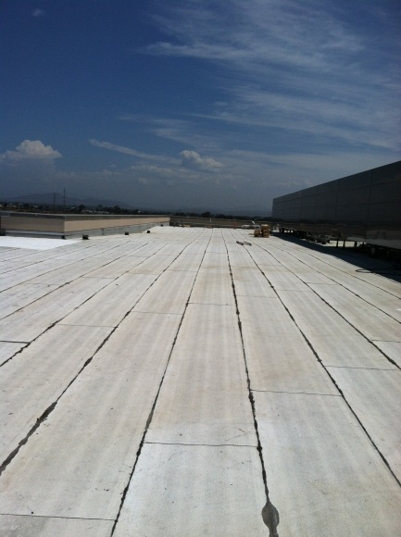
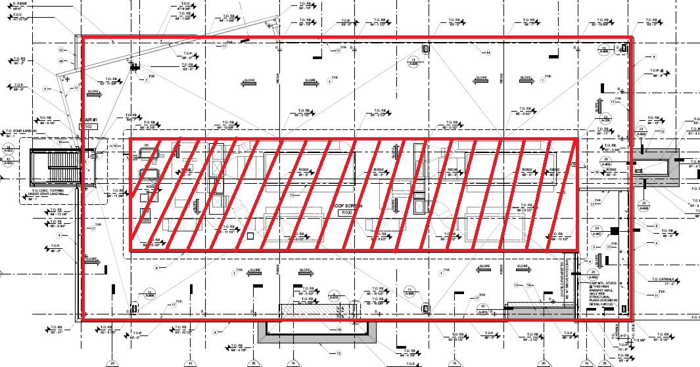
Solar Panel Installation | Background Information
Background Information
| Introduction
| Prefabricated Exterior Wall Panels
| Detailed Sequencing
Roof made of EPDM membrane, rigid insulation, concrete on metal deck
30,250 SF total roof space (125’ x 242’)
9,900 SF centrally located mechanical space (50’ x 198’)
Mechanical space surrounded by 13 ½’ screen wall
Parapet walls 4’
| Sizing of Rigging Beam
| Solar Panel Installation at Roof Level
| Mobile Technology Integration- Tablet Computers
| Recommendations
| Concluding Remarks
Photo of Rooftop and Plan View of Rooftop
Notes:
The project team finds out that they are only a few leed credits away from leed gold. Owner decides it might be worth it if appropriate solution is found.

Slide 30
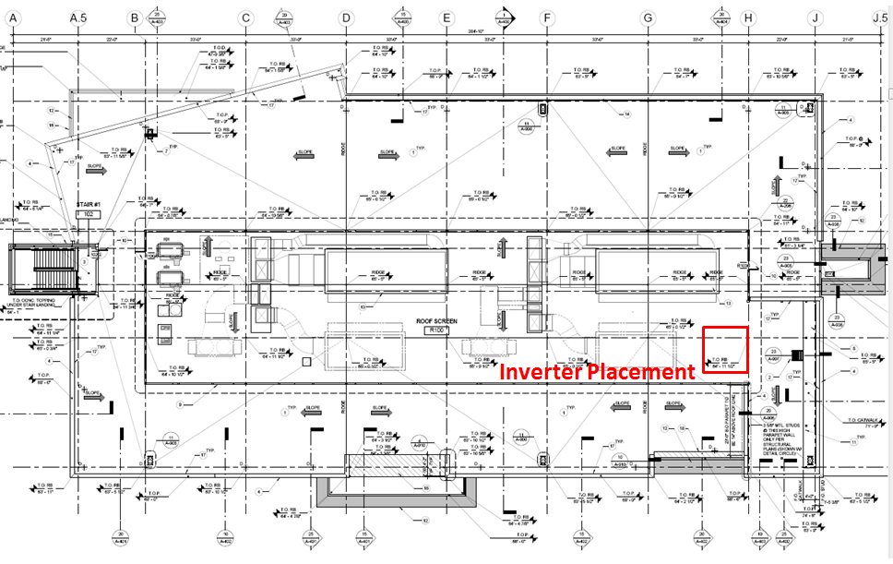
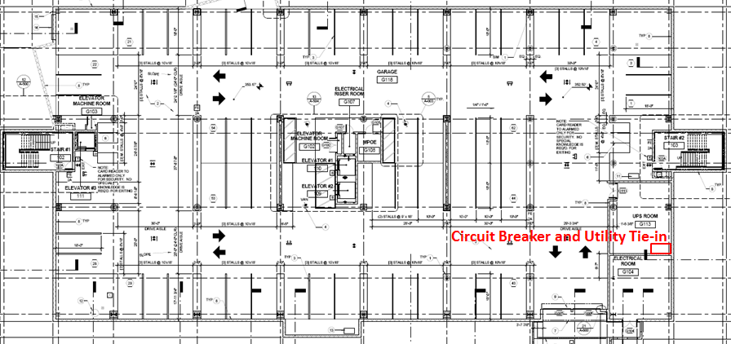
Solar Panel Installation | Design Decisions
Design Decisions
| Introduction
| Prefabricated Exterior Wall Panels
Rooftop
| Detailed Sequencing
Grid Direct System (DC to AC Power) connected to utility
Inverter placed at east side of the rooftop mechanical zone
Circuit breakers and utility tie-in placed in basement main electrical room
| Sizing of Rigging Beam
| Solar Panel Installation at Roof Level
| Mobile Technology Integration- Tablet Computers
| Recommendations
| Concluding Remarks
Basement

Slide 31
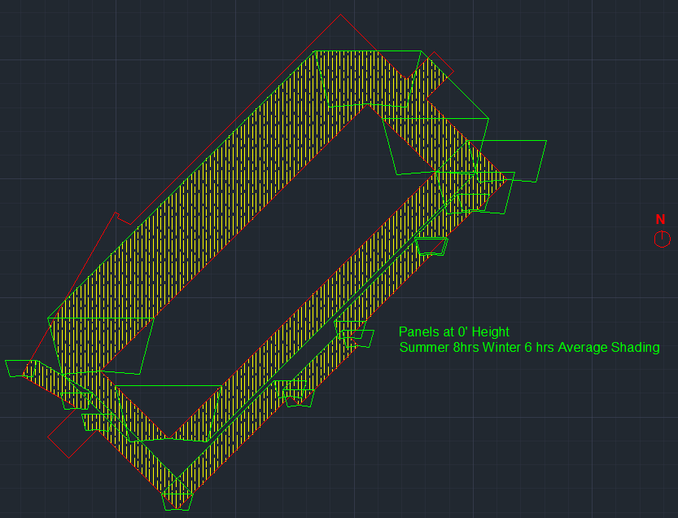
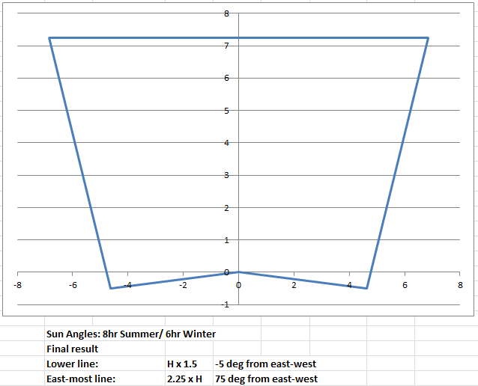
Solar Panel Installation | Shading Analysis
Shading Analysis
| Introduction
| Prefabricated Exterior Wall Panels
| Detailed Sequencing
| Sizing of Rigging Beam
| Solar Panel Installation at Roof Level
| Mobile Technology Integration- Tablet Computers
| Recommendations
| Concluding Remarks

Slide 32
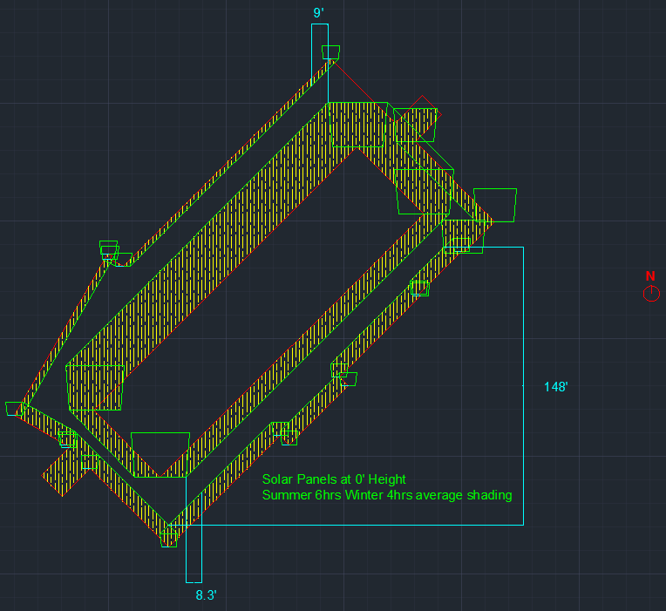
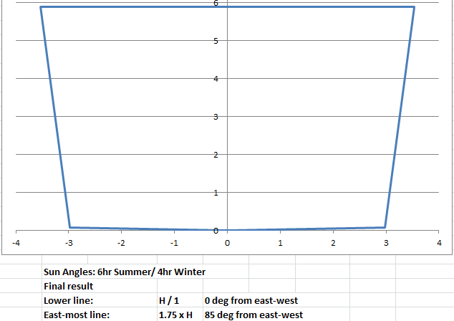
Solar Panel Installation | Shading Analysis
Shading Analysis
| Introduction
| Prefabricated Exterior Wall Panels
| Detailed Sequencing
| Sizing of Rigging Beam
| Solar Panel Installation at Roof Level
| Mobile Technology Integration- Tablet Computers
| Recommendations
| Concluding Remarks

Slide 33
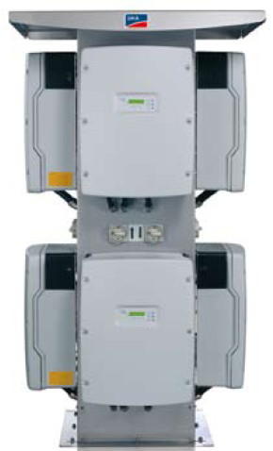
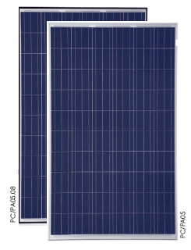
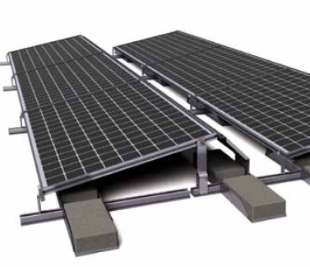
Solar Panel Installation | System Design
Module, Inverter, and Racking
Inverter: Sunny Tower by SMA
| Introduction
Criteria | Large, single inverter
Efficiency | 96%
Maximum Load | 42 kWdc power
| Prefabricated Exterior Wall Panels
Module: Trinamount TSM-250PA05
| Detailed Sequencing
Criteria | Best efficiency for cost
Efficiency | 15.3%
Maximum Power | 250 W
Size | 3 ¼’ x 5 ½’
| Sizing of Rigging Beam
| Solar Panel Installation at Roof Level
| Mobile Technology Integration- Tablet Computers
Racking: Trinamount III
| Recommendations
Type | Ballasted racking system
Tilt | 11 degrees
| Concluding Remarks
Notes:
Key notes: Module picked based on best cost for highest efficiency, inverter picked in order to have one central connection point, ballast racking system chosen to reduce roof penetrations and ease installation. 11 degree tilt in order to fit more panels

Slide 34
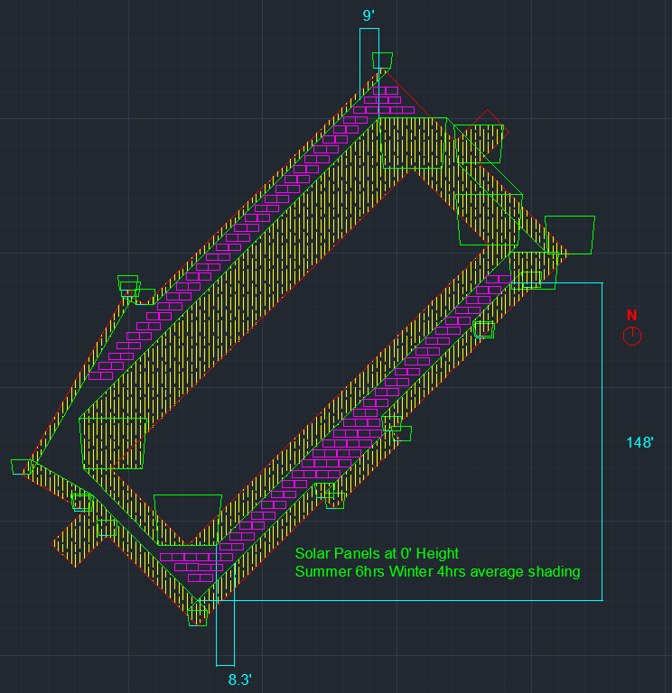
Solar Panel Installation | System Design
Array Placement
| Introduction
| Prefabricated Exterior Wall Panels
Module Amount | 143 modules
System Max Output | 36 kWdc
| Detailed Sequencing
| Sizing of Rigging Beam
| Solar Panel Installation at Roof Level
| Mobile Technology Integration- Tablet Computers
| Recommendations
| Concluding Remarks
Array Layout

Slide 35
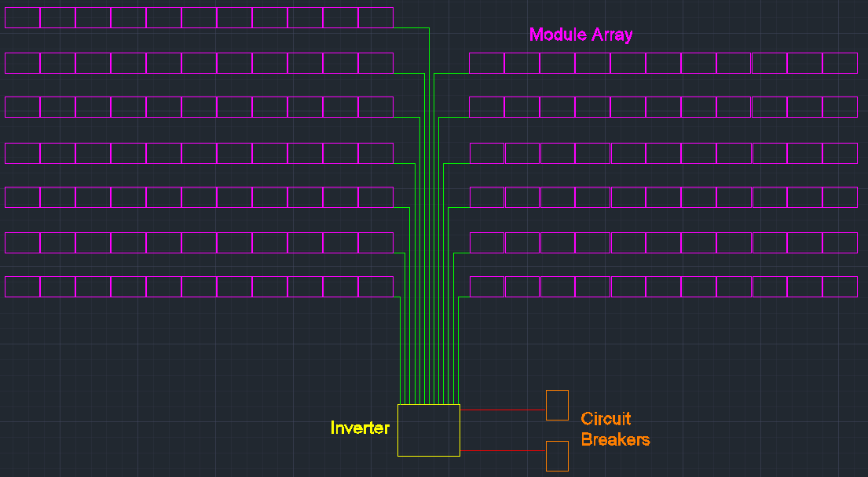
Solar Panel Installation | System Design
Electrical Sizing and Design
| Introduction
| Prefabricated Exterior Wall Panels
| Detailed Sequencing
13 Strings, 11 Modules per string
| Sizing of Rigging Beam
| Solar Panel Installation at Roof Level
Conductor Sizing Summary
Connection | Description | Legend
Panels String to Inverter (DC Side)
Conductor Sizing (One Way) | (5) #12 AWG’s per PV Output Circuit String
Maximum Run Length | 187 ft. one way for 2% Voltage Drop
Inverter to Circuit Breakers (AC Side)
Conductor Sizing (One Way) | (3) #4 AWG conductors per 80-amp breaker
Maximum Run Length | 85 ft. one way for 1.5% Voltage Drop
Circuit Breaker Sizing | (2) 80-amp circuit breakers
| Mobile Technology Integration- Tablet Computers
| Recommendations
| Concluding Remarks
Riser Diagram of PV System

Slide 36
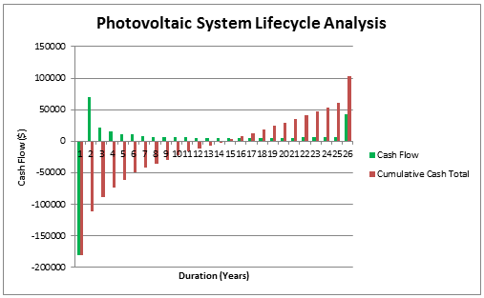
Solar Panel Installation | Construction Analysis
Cost Analysis
| Introduction
| Prefabricated Exterior Wall Panels
System Direct Cost | $180,534
System Production | 47,000 kWh / year
System Production ($) | $6,110 / year
Incentives | 30% Fed. Tax Credit, $.05 / kWh State Credit
| Detailed Sequencing
| Sizing of Rigging Beam
| Solar Panel Installation at Roof Level
| Mobile Technology Integration- Tablet Computers
| Recommendations
| Concluding Remarks
14 year Payback Period

Slide 37
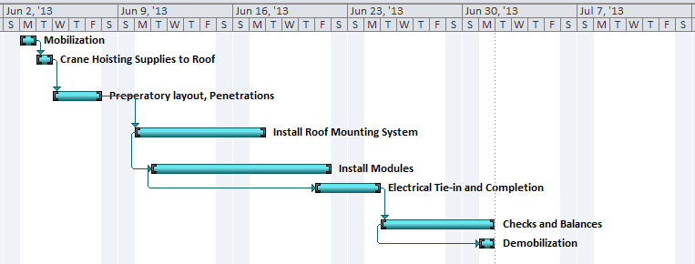
Solar Panel Installation | Construction Analysis
Schedule Analysis
| Introduction
| Prefabricated Exterior Wall Panels
Duration | 4 weeks
Construction Concerns | Roof membrane, organization, system balance
| Detailed Sequencing
| Sizing of Rigging Beam
| Solar Panel Installation at Roof Level
| Mobile Technology Integration- Tablet Computers
| Recommendations
| Concluding Remarks
Schedule for Photovoltaic System Installation
Notes:
Construction Concerns: racking and roof, organization based on space, balancing systems

Slide 38
Solar Panel Installation | Recommendation
| Introduction
| Prefabricated Exterior Wall Panels
| Detailed Sequencing
| Sizing of Rigging Beam
| Solar Panel Installation at Roof Level
Do not install solar panels at roof level.
| Mobile Technology Integration- Tablet Computers
| Recommendations
| Concluding Remarks
Notes:
To much shading, not large enough system or production. If owner does feel as though it is worth it to attain LEED Gold, then go for it

Slide 39
Mobile Technology Integration | Overview
| Introduction
| Prefabricated Exterior Wall Panels
| Detailed Sequencing
| Sizing of Rigging Beam
Mobile Technology Integration
-Tablet Computers-
| Solar Panel Installation at Roof Level
| Mobile Technology Integration- Tablet Computers
| Recommendations
| Concluding Remarks

Slide 40
Mobile Technology Integration | Problem Identification
Problem
| Introduction
| Prefabricated Exterior Wall Panels
| Detailed Sequencing
Engineers and site management following inefficient processes
Data entry, field coordination, communication, organization- inefficient
Available technology underutilized
General Conditions competitive in this market
| Sizing of Rigging Beam
| Solar Panel Installation at Roof Level
| Mobile Technology Integration- Tablet Computers
| Recommendations
| Concluding Remarks

Slide 41
Mobile Technology Integration | Case Study #1
ASCE Journal: Making the Case for Mobile IT in Construction
Results
| Introduction
| Prefabricated Exterior Wall Panels
| Detailed Sequencing
Industry slow to change and adopt new information technologies
Barriers include: low profit margin for GC, hesitation towards benefits, lack of awareness, lack of success stories
Analyzed 11 construction projects
Reports generate faster and easier
Increased customer service
Ability to identify trends
Reduced task turn around time
Increased quality and efficiency
| Sizing of Rigging Beam
| Solar Panel Installation at Roof Level
| Mobile Technology Integration- Tablet Computers
| Recommendations
| Concluding Remarks

Slide 42
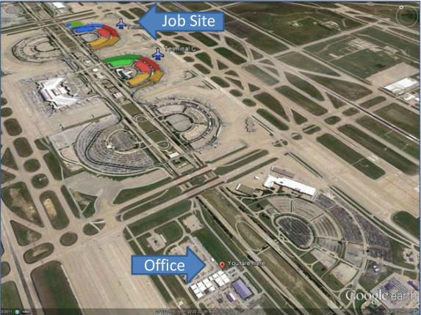
Mobile Technology Integration | Case Study #2
DFW Airport- Terminal Renovation and Improvement Project
Results
| Introduction
| Prefabricated Exterior Wall Panels
Cost | $900M
Duration | 7 years
Size | 2,000,000 SF
Main Implementation
Updated Electronic Drawings
Coordination in the Field
Results
Improved Efficiency
Reprographics Cost Decrease of 71% or $5.1M
Lessons Learned
Technology Must Have an Implementation Plan
Architect Must be On-board
Project Closeout and Archiving
Engineers Save 1 hr/day from Tablet Integration
Must Have Sole "Gatekeeper" of E-Documents
| Detailed Sequencing
| Sizing of Rigging Beam
| Solar Panel Installation at Roof Level
| Mobile Technology Integration- Tablet Computers
| Recommendations
| Concluding Remarks

Slide 43

Mobile Technology Integration | Case Study #3
Pharmaceutical Processing Plant
(Los Angeles, CA)
Results
| Introduction
| Prefabricated Exterior Wall Panels
Cost | $150M
Duration | 2 ½ years
Size | 90,000 SF
Main Implementation
Updated Electronic Drawings
Coordination in the Field and RFI's
Results
Lessons Learned
Tablet Becomes Integral. Must Keep With You
Roadblocks with Technology (3D Model, Opening File Types)
Safety Evaluations
Engineers Save 1.1 hr/day from Tablet Use
Must Have Sole "Gatekeeper" of E-Documents
Reprographics Cost Decrease $4000/Addendum
Superintendents Save 1.5 hr/day from Tablet Use
| Detailed Sequencing
| Sizing of Rigging Beam
| Solar Panel Installation at Roof Level
| Mobile Technology Integration- Tablet Computers
| Recommendations
| Concluding Remarks

Slide 44
Mobile Technology Integration | Means and Methods
Original Practices
| Introduction
| Prefabricated Exterior Wall Panels
On Site Management | 4 people
Technology | Laptop Computers in Jobsite Office
Drawings | Electronic and Paper (Mainly Paper)
Storage | Cloud Server
| Detailed Sequencing
| Sizing of Rigging Beam
| Solar Panel Installation at Roof Level
| Mobile Technology Integration- Tablet Computers
| Recommendations
| Concluding Remarks

Slide 45
Mobile Technology Integration | Application to RFCS
Proposed Tablet Integration Plan
| Introduction
| Prefabricated Exterior Wall Panels
On Site Management | 4 people
Technology | Table Computers & Laptop Computers in Jobsite Office
Drawings | Electronic and Paper (Mainly Electronic)
Storage | Cloud Server
Accessing Drawings in the Field
Documenting Field Issues
Email and Correspondence
Safety Evaluations
Daily Forms and Checklists
Coordination in the Field
| Detailed Sequencing
| Sizing of Rigging Beam
| Solar Panel Installation at Roof Level
| Mobile Technology Integration- Tablet Computers
| Recommendations
| Concluding Remarks
Proposed Uses for Tablet Computers at RFCS

Slide 46
Mobile Technology Integration | Analysis
Costs of Tablet Computer Implementation
| Introduction
Direct Costs of Tablet Computer Implementation
Description | Quantity | Cost/Unit | Cost
Tablet Computers | 4 | $500/iPad | -($2,000)
Contingency for Software & Add-ons | 4 | $300/iPad | -($1,200)
Training Project Manager | 6 hours | - | -($624)
Training Superintendent | 6 hours | - | -($624)
Training Project Engineer #1 | 6 hours | - | -($408)
Training Project Engineer #2 | 6 hours | - | -($408)
Total | - | - | -($5,264)
| Prefabricated Exterior Wall Panels
| Detailed Sequencing
Direct Costs | -($5,264)
Weekly Human Resource Savings | $1,688/ week
Overall Project Savings | $116,272
Benefits | Efficiency, Quality, Customer Service
| Sizing of Rigging Beam
| Solar Panel Installation at Roof Level
| Mobile Technology Integration- Tablet Computers
Human Resource Costs of Tablet Integration (Weekly)
Description | Quantity | Cost/Unit | Cost
Costs
IT Champion Time | 2 hours | $68/hour | -($136)
Savings
Project Manager Time | 4 | - | $416
Superintendent Time | 7 | - | $728
Project Engineer #1 Time | 5 | - | $340
Project Engineer #2 Time | 5 | - | $340
Total | - | - | $1688/week
| Recommendations
| Concluding Remarks
Costs of Tablet Computer Integration

Slide 47
Mobile Technology Integration | Recommendations
| Introduction
| Prefabricated Exterior Wall Panels
| Detailed Sequencing
| Sizing of Rigging Beam
| Solar Panel Installation at Roof Level
Implement tablet computers at RFCS.
| Mobile Technology Integration- Tablet Computers
| Recommendations
| Concluding Remarks

Slide 48
Recommendations | Overview
| Introduction
| Prefabricated Exterior Wall Panels
| Detailed Sequencing
| Sizing of Rigging Beam
Final Recommendations
| Solar Panel Installation at Roof Level
| Mobile Technology Integration- Tablet Computers
| Recommendations
| Concluding Remarks

Slide 49
Recommendations | Overall Thoughts
Final Recommendations
| Introduction
| Prefabricated Exterior Wall Panels
| Detailed Sequencing
1. Implement Partially Prefabricated Wall Panel Strategy as opposed to original stick-built construction.
2. Do not install solar panels at roof level.
3. Implement tablet computers at RFCS.
| Sizing of Rigging Beam
| Solar Panel Installation at Roof Level
| Mobile Technology Integration- Tablet Computers
| Recommendations
| Concluding Remarks

Slide 50
Concluding Remarks | Overview
| Introduction
| Prefabricated Exterior Wall Panels
| Detailed Sequencing
| Sizing of Rigging Beam
Concluding Remarks
| Solar Panel Installation at Roof Level
| Mobile Technology Integration- Tablet Computers
| Recommendations
| Concluding Remarks

Slide 51
Concluding Remarks | Reflection
Reflection
| Introduction
| Prefabricated Exterior Wall Panels
Design Goal
| Detailed Sequencing
Increase value through innovative and efficient construction.
| Sizing of Rigging Beam
| Solar Panel Installation at Roof Level
Outcome
| Mobile Technology Integration- Tablet Computers
Schedule savings through innovative panel prefabrication.
Alternative energy system analyzed
Comprehensive and beneficial study of mobile technology integration
| Recommendations
| Concluding Remarks
Successful Study

Slide 52
Concluding Remarks | Acknowledgements
Thank you!
| Introduction
| Prefabricated Exterior Wall Panels
| Detailed Sequencing
DPR Construction
AE Faculty
PSU Department of Sustainability
Audience
| Sizing of Rigging Beam
| Solar Panel Installation at Roof Level
| Mobile Technology Integration- Tablet Computers
| Recommendations
| Concluding Remarks

Slide 53
Concluding Remarks | Appendix
C-CAPP Estimate
Partial Panel Prefabrication Estimate
| Introduction
| Prefabricated Exterior Wall Panels
| Detailed Sequencing
| Sizing of Rigging Beam
Quote on C-CAPP Prefabricated Panel System
Cost Breakdown ($) |  | Schedule (Duration)
Base Budget | $907,500 | Preliminary | Variable
Staining Panels | $99,500
Preweld Connections to Steel Structure | $75,000 | Layout and Preweld | 3 weeks
Caulking | $33,000 | Hanging Panels | 1 week
----------------------------------------------- | -------------- | Final Aligning and Welding | 3 weeks
Total Cost of System | $1,115,000 | Total Duration on site | 7 weeks
| Solar Panel Installation at Roof Level
| Mobile Technology Integration- Tablet Computers
| Recommendations
| Concluding Remarks

Slide 54
Concluding Remarks | Appendix
Solar Panel System Estimate
RFCS Costs and Building Use
| Introduction
| Prefabricated Exterior Wall Panels
Direct Costs for Solar Panel Installation
Description | Cost/Unit | Quantity | Total Cost | Reference
Modules | $190/Module | 144 | $27,360 | Sunwize Quote
Ballast Racking System | $0.30/Watt | 35730 | $10,720 | Rocky Mountain Institute
Inverter | $19553/Unit | 1 | $19,553 | Affordable Solar Quote
DC Wiring #12 AWG | $0.74/LF | 12400 | $9,176 | RSMEANS
DC Conduit 3/4" | $10.50/LF | 2480 | $26,040 | RSMEANS
AC Wiring #4 AWG | $2.29/LF | 250 | $573 | RSMEANS
AC Conduit 1" | $12.45/LF | 250 | $3,113 | RSMEANS
Circuit Breakers 80 AMP | $1025/Ea | 2 | $2,050 | RSMEANS
Crane Rental (Truck Crane 4,000 lb. Capacity) | $4200/day | 2 | $8,400 | RSMEANS
Shipping | $190/Pallet | 11 | $2,090 | Sunwize Quote
Labor | $3/Watt | 35730 | $107,190 | Sunwize Rec.
Total | - | - | $180,534
Major Costs for Research Facility Core and Shell
 | Construction Cost | Cost/SF
Actual Building Construction | $16,031,402 | $125.86
Total Project | $20,035,000 | $157.29
Mechanical System | $1,574,261 | $12.36
Electrical System | $1,014,666 | $7.97
Plumbing System | $662,250 | $5.20
Fire Protection | $298,462 | $2.34
Structural System | $5,238,945 | $41.13
Exterior Skin | $4,089,261 | $32.10
| Detailed Sequencing
| Sizing of Rigging Beam
| Solar Panel Installation at Roof Level
| Mobile Technology Integration- Tablet Computers
| Recommendations
Building Use Description
Level | Size | Use
Underground Parking Garage | 31,197 SF | Parking; UPS, Electrical & Elevator Machine Rooms
First Floor | 31,850 SF | Lobby, Laboratory Space
Second Floor | 31,850 SF | Offices, Laboratory Rooms
Third Floor | 31,850 SF | Offices, Laboratory Rooms
Fourth Floor | 31,850 SF | Offices
Roof | 31,850 SF | Large Mechanical Equipment
| Concluding Remarks

